Slide 1
Secure Data Hiding in Images Using Steganography
Presented by:
SILAPARASETTY JASWANTH[STU649fcff0671cb1688195056]
BITS VIZAG, CSE DEPARTMENT

Slide 2
Outline:
Problem Statement
Technology Used
Wow Factor
End Users
Results
Conclusion
GitHub Link
Future Scope

Slide 3
Problem Statement:
In the digital age, secure communication is critical. Steganography provides a solution by hiding sensitive data within images, ensuring confidentiality and preventing unauthorized access. This project focuses on secure data hiding in images using steganography techniques.

Slide 4
Technology Used:
Programming Language: Python
Libraries: OpenCV, Pillow, NumPy, Stegano
Platform: Jupyter Notebook, PyCharm
Algorithm: LSB (Least Significant Bit) for image steganography

Slide 5
Wow Factor:
Unique Features:
High data security with minimal visual distortion in images.
Supports multiple image formats (PNG, JPEG, BMP).
Real-time encoding and decoding of hidden data.
User-friendly interface for seamless operation.

Slide 6
End Users:
Primary Users:
Government agencies for secure communication.
Military for transmitting confidential data.
Corporations for protecting intellectual property.
Secondary Users:
Individuals for personal data privacy.

Slide 7
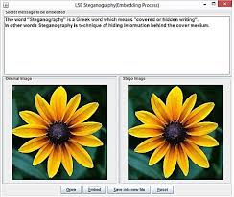
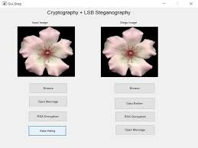
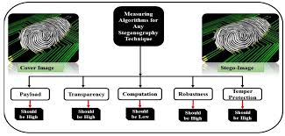
Results:

Slide 8
Conclusion:
The project successfully demonstrates the implementation of steganography for secure data hiding in images. It ensures confidentiality and integrity of hidden information, addressing the problem statement effectively. The LSB algorithm provides a robust and efficient solution for covert communication.

Slide 9
GitHub Link:
GitHub Repository: [https://github.com/jaswanth0711/STEGANOGRAPHY.git]
Includes a detailed README file with project setup instructions, usage, and examples.

Slide 10
Future Scope:
Extend support for other media types (audio, video).
Enhance encryption for added security (e.g., AES encryption).
Develop a mobile application for on-the-go steganography.
Explore AI-based steganography for adaptive data hiding.

Slide 11
Thank You

